Slide 1

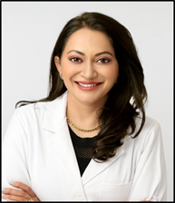
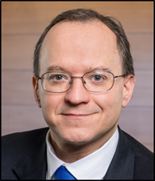

Princeton Graduate School 125th Anniversary
Leveraging Many Minds, Many Stripes:
Graduate School's 125th to Engage Alumni
Anita Gupta *18
Graduate Chair
Princeton Club of San Diego
Member, CORA
Scott J. Steele *03 P28
President
Princeton Club of Rochester
Member, CORA
Notes:
Anita and Scott

Slide 2
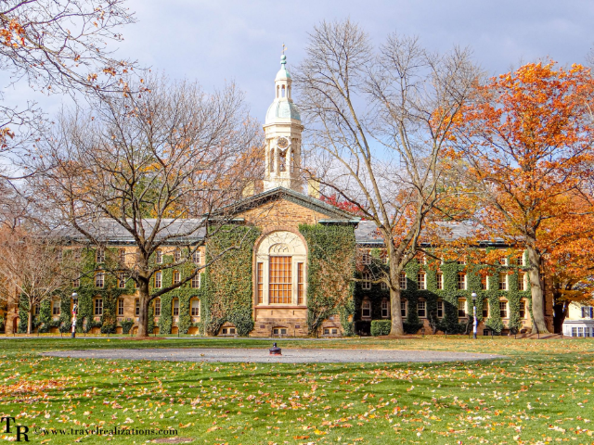
A Historic Milestone
Two momentous occasions in the life of our university: the 125th Anniversary of the Graduate School and the 75th Anniversary of the Association of Princeton Graduate Alumni (APGA).
This event is more than a celebration; it is a reaffirmation of the vital role graduate education plays in shaping knowledge and society.
Notes:
Anita

Slide 3

A Legacy of Excellence
1900
37k+
18
FOUNDED
DEGREES AWARDED
NOBEL LAUREATES
125 years of graduate education history.
A global network of scholars and leaders.
Recognized for groundbreaking contributions to humanity.
Notes:
Scott

Slide 4
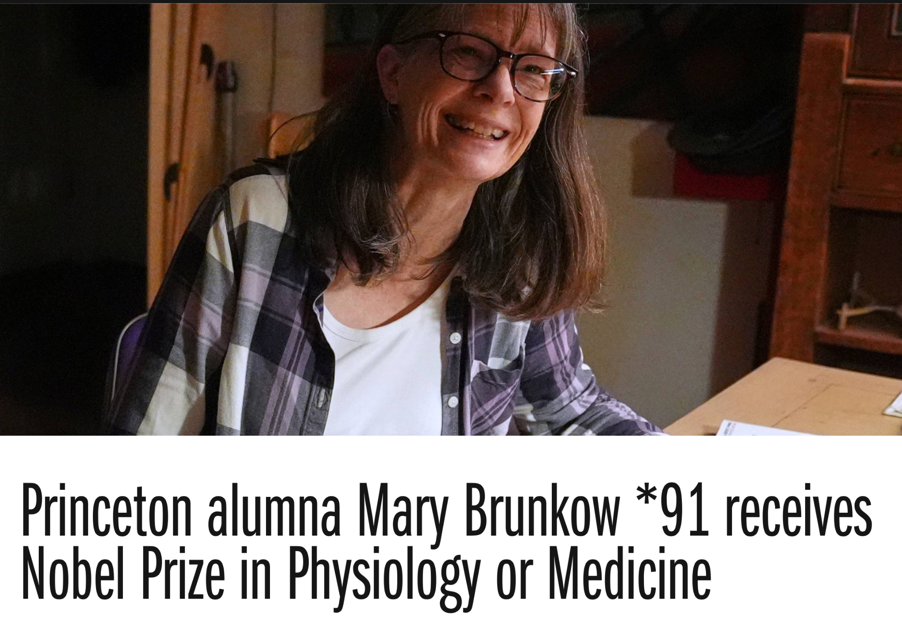
A Legacy of Excellence- Mary Brunkow *91 (Molbio)
https://www.princeton.edu/news/2025/10/06/princeton-alumna-mary-brunkow-91-receives-nobel-prize-physiology-or-medicine
Notes:
Scott
October, 2025

Slide 5
"Many Minds, Many Stripes"- Leadership Vision
"We hope alumni will return to be part of the excitement, reunite with friends, faculty, and staff, and celebrate the transformational impact of a Princeton graduate education."
Rodney Priestley
Dean of the Graduate School
Notes:
Scott

Slide 6

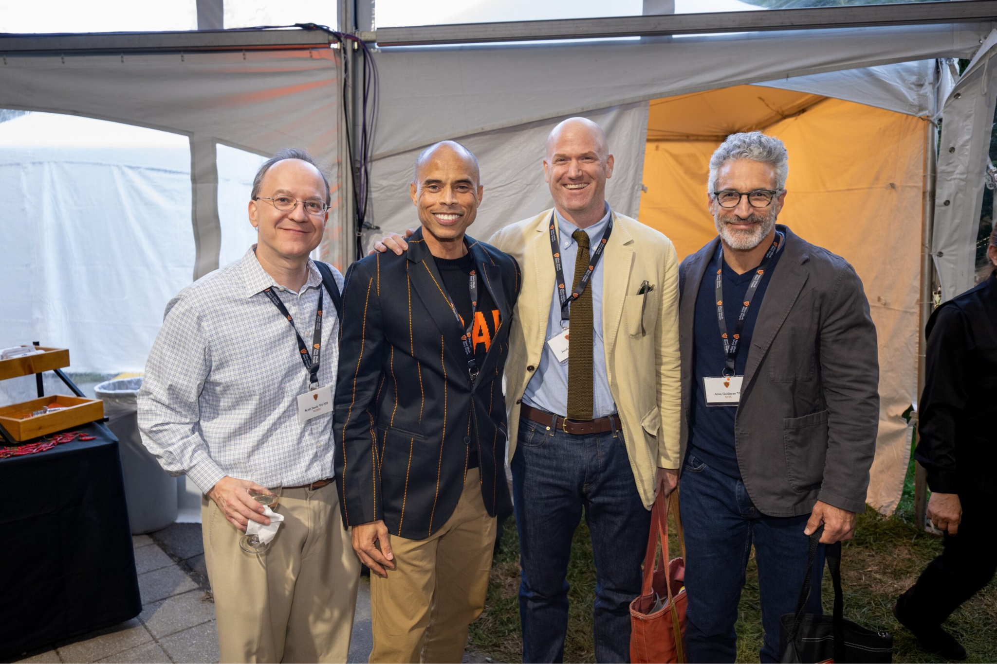
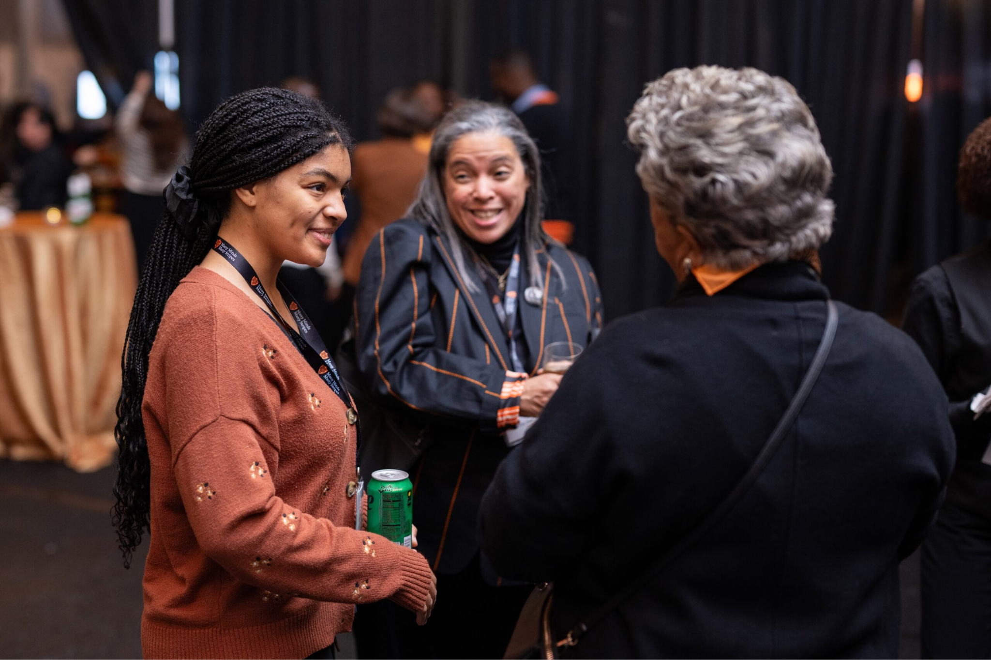
The Theme: "Many Minds, Many Stripes"
Intellectual Diversity: "Many Minds" reflects the vast array of disciplines, perspectives, and intellectual contributions our alumni bring to the world.
Shared Identity: "Many Stripes" playfully nods to our Tiger mascot while acknowledging the unique paths and careers ("stripes") each alumnus has forged.
Unity in Difference: Together, these phrases symbolize a community bound by excellence but defined by its rich variety.
Notes:
Scott

Slide 7
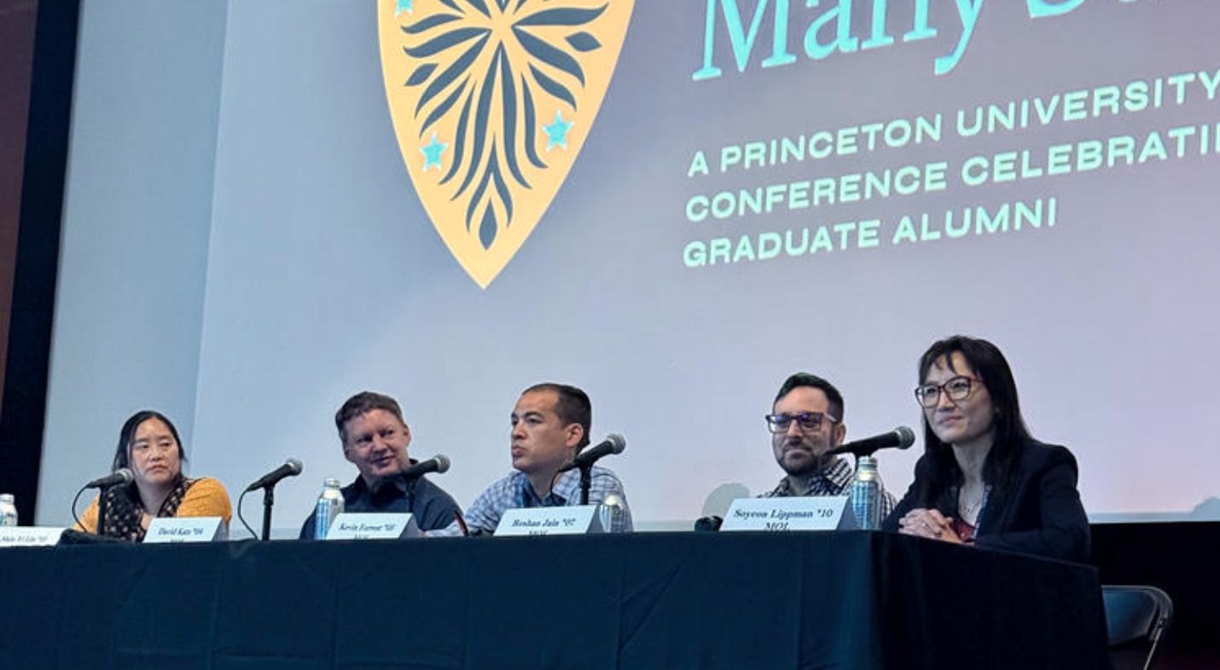






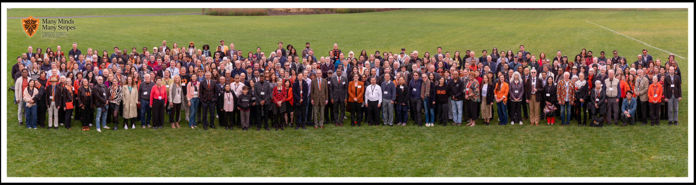
Conference Agenda Highlights
Alumni Panels
Faculty Lectures
Networking
Discussions on AI, climate change, ethics, and leadership featuring distinguished alumni experts.
Exclusive sessions with top Princeton faculty sharing cutting-edge research and insights.
Receptions, department gatherings, and social events to reconnect with peers and mentors.
Notes:
Scott

Slide 8
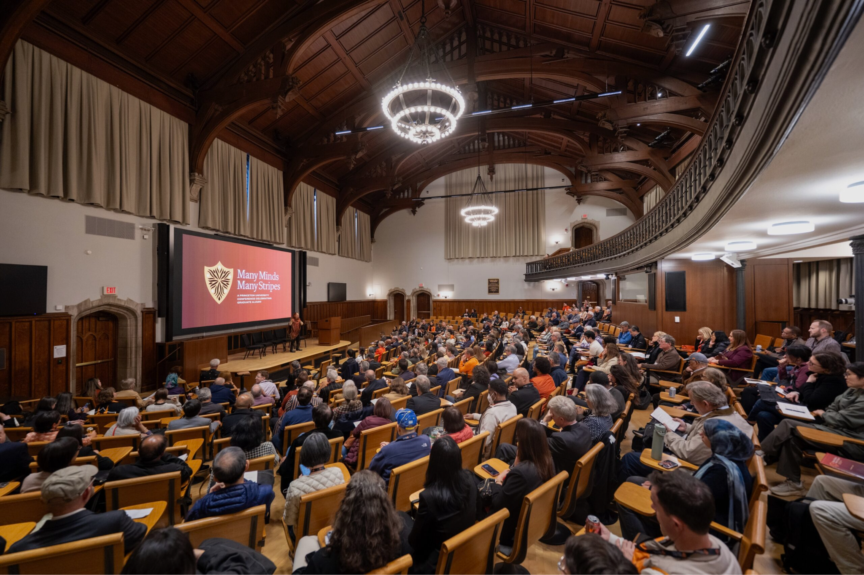
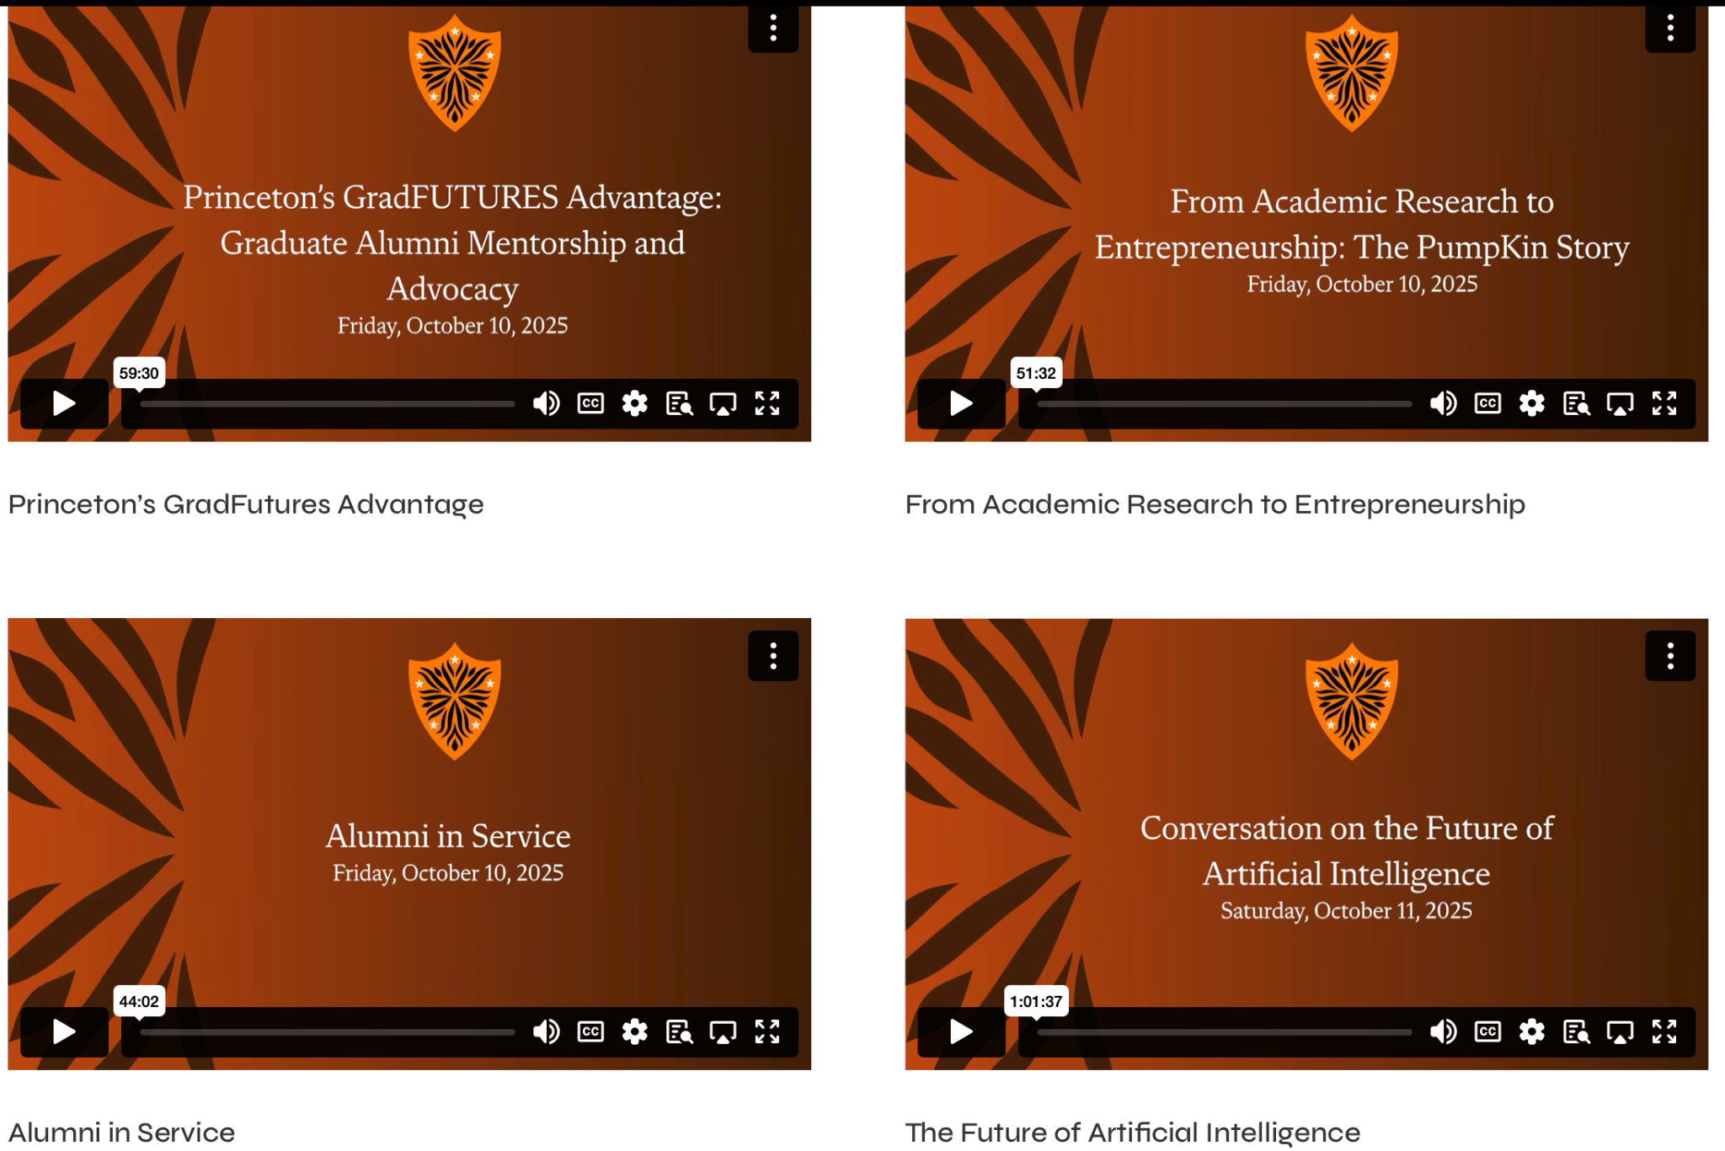
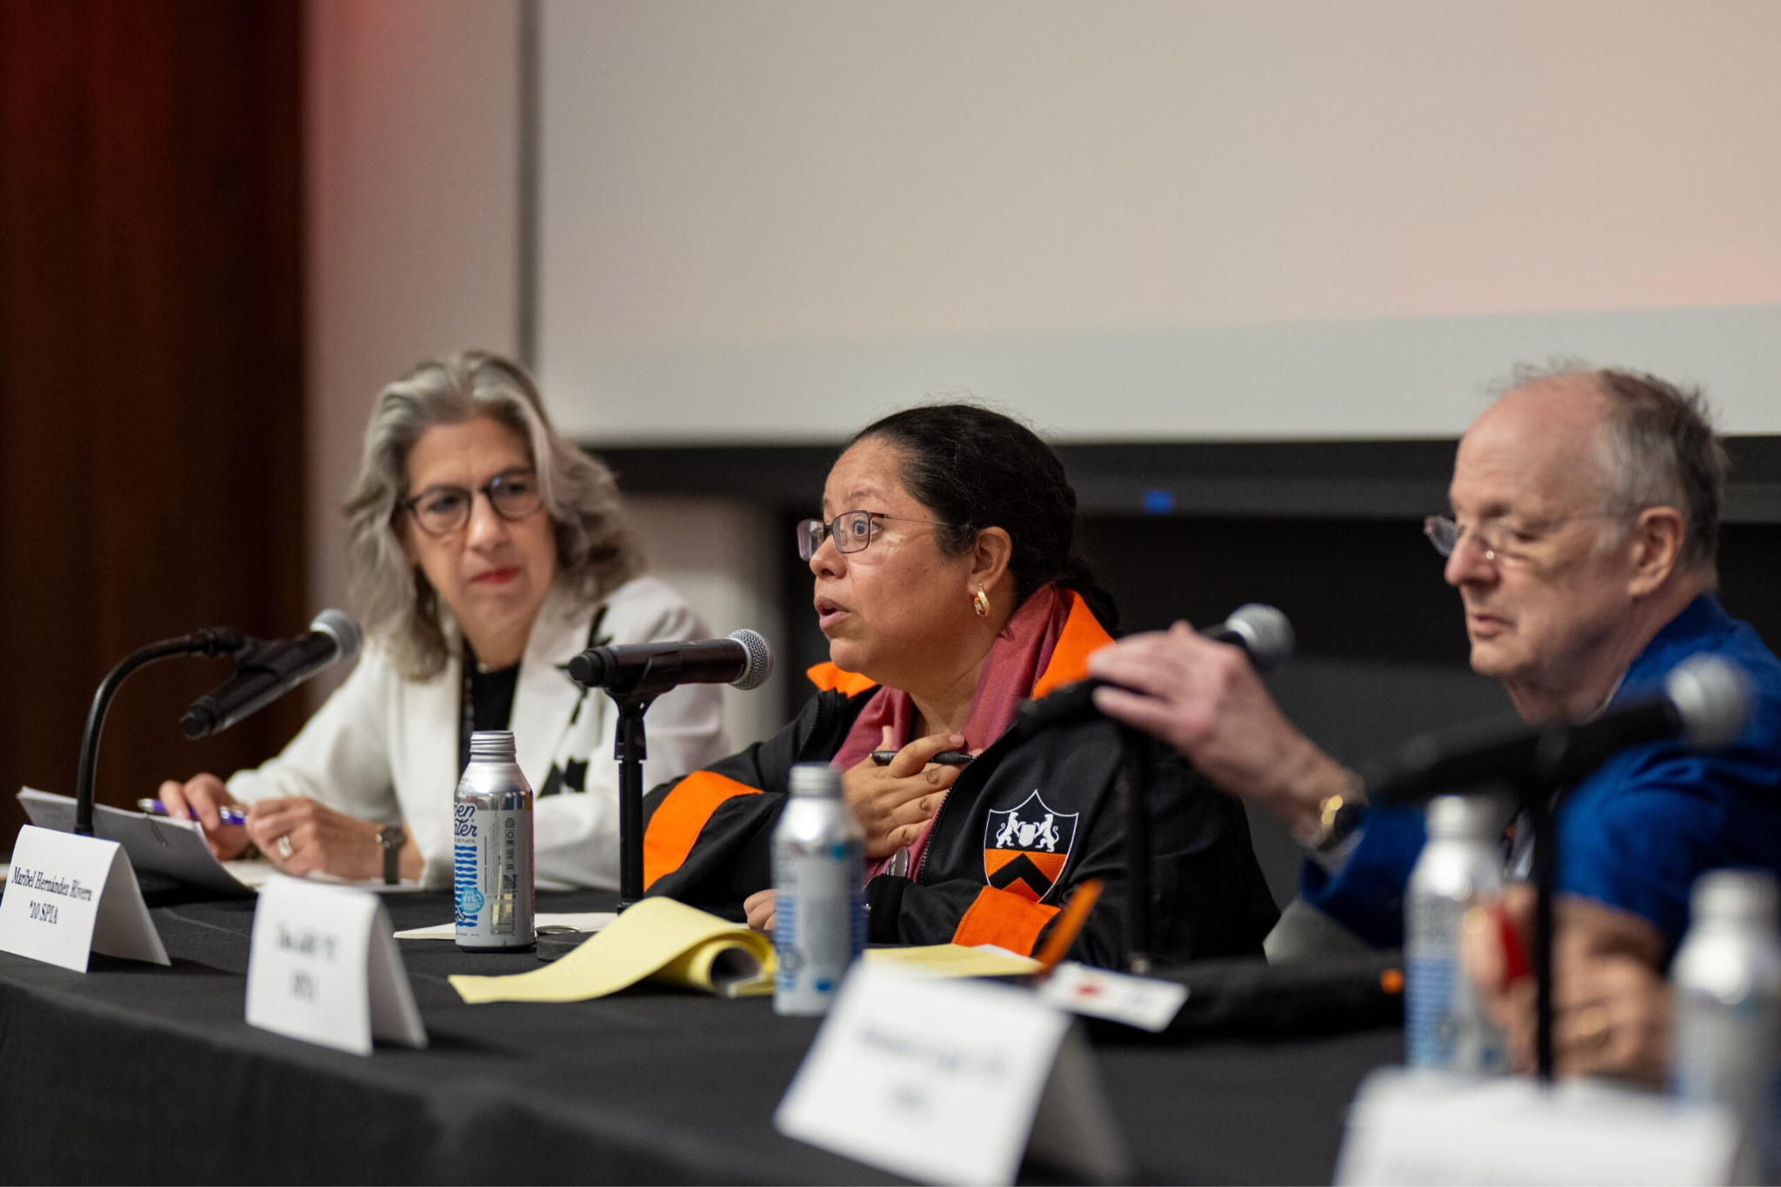
Many Minds: Resources and Reflections
Videos: Standalone, seed for a precept, career panel or other event (Inspired conversations toolkit)
Utilize themes and specific topics for regional events, speakers (TigerSide Chats, Speakers Bureau)
Consider engaging relevant departments and programs?
https://manyminds.alumni.princeton.edu/videos/
Notes:
Scott
Resources
Utilizing videos for events/discussion/precept
Using Princeton pre-read
Highlight department focus and engagement
Speakers bureau

Slide 9
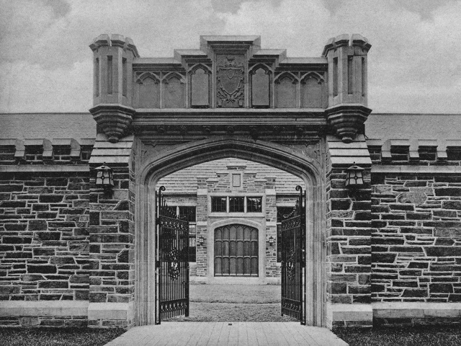
Then and Now: 1900 vs. Today
1900: The Graduate School is formally incorporated, setting a new standard for advanced scholarship in America.
Growth: From a small cohort of scholars to a diverse community of over 3,000 current students.
Evolution: While the commitment to truth remains constant, our disciplines have expanded to include bioengineering, quantum science, and public policy.
Princeton Press Gate, 1900s
Notes:
Transition to Anita here

Slide 10
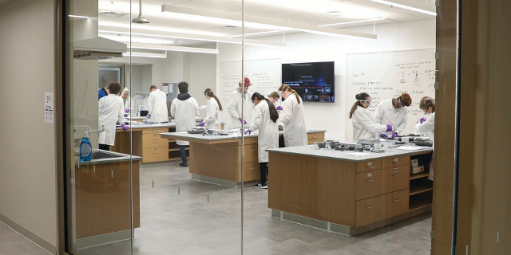
Graduate Alumni Impact
Our alumni use their "stripes" to make an impact across every sector of society.
From leading Fortune 500 companies and shaping public policy to driving scientific breakthroughs and enriching the arts, Princeton graduates are at the forefront of global change.
Notes:
Anita

Slide 11
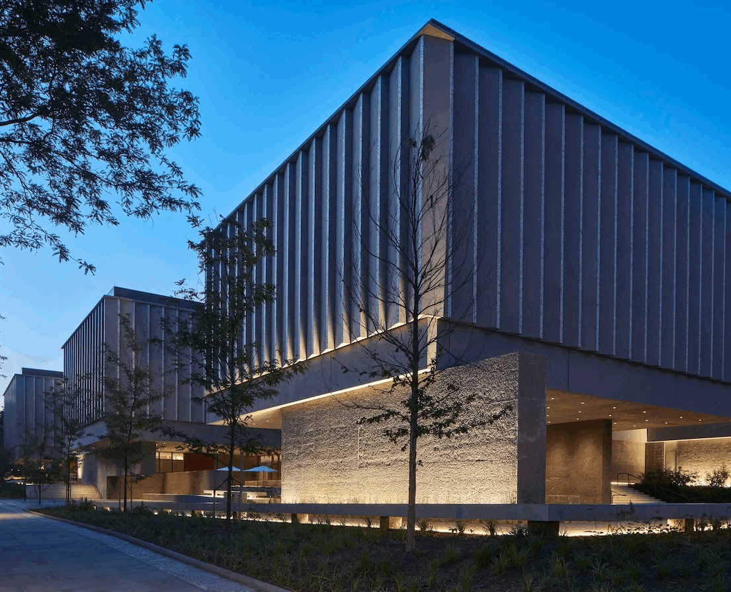
Looking Ahead: The Next 125 Years
Innovation: Investing in state-of-the-art facilities like the new bioengineering institute to foster interdisciplinary research.
Inclusion: Expanding access and support to ensure the most talented minds from all backgrounds can thrive.
Impact: Preparing the next generation of scholars to solve the "wicked problems" of the 21st century.
Princeton Art Museum, 2025
Notes:
Anita

Slide 12
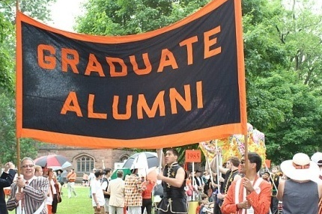
The Graduate Network
With over 30,000 living alumni residing in 19% of the world's countries, the Princeton Graduate School community is truly global.
This network is a powerful resource for professional development, intellectual exchange, and lifelong friendship.
Notes:
Anita

Slide 13
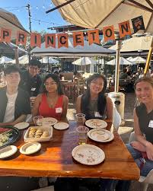
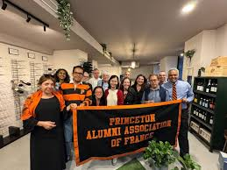
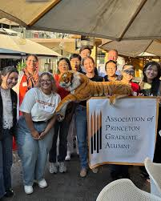






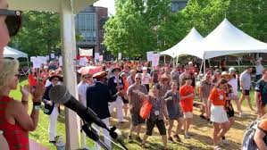
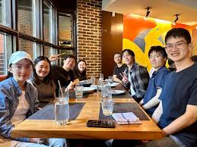
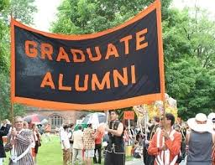
How Grad Alumni
Get Involved
Mentorship
Events
Connect
Guide current students through the GradFUTURES mentorship program.
Attend regional alumni gatherings and future "Many Minds" conferences.
Join the digital community on the "TigerNet" alumni platform.
Notes:
Anita

Slide 14
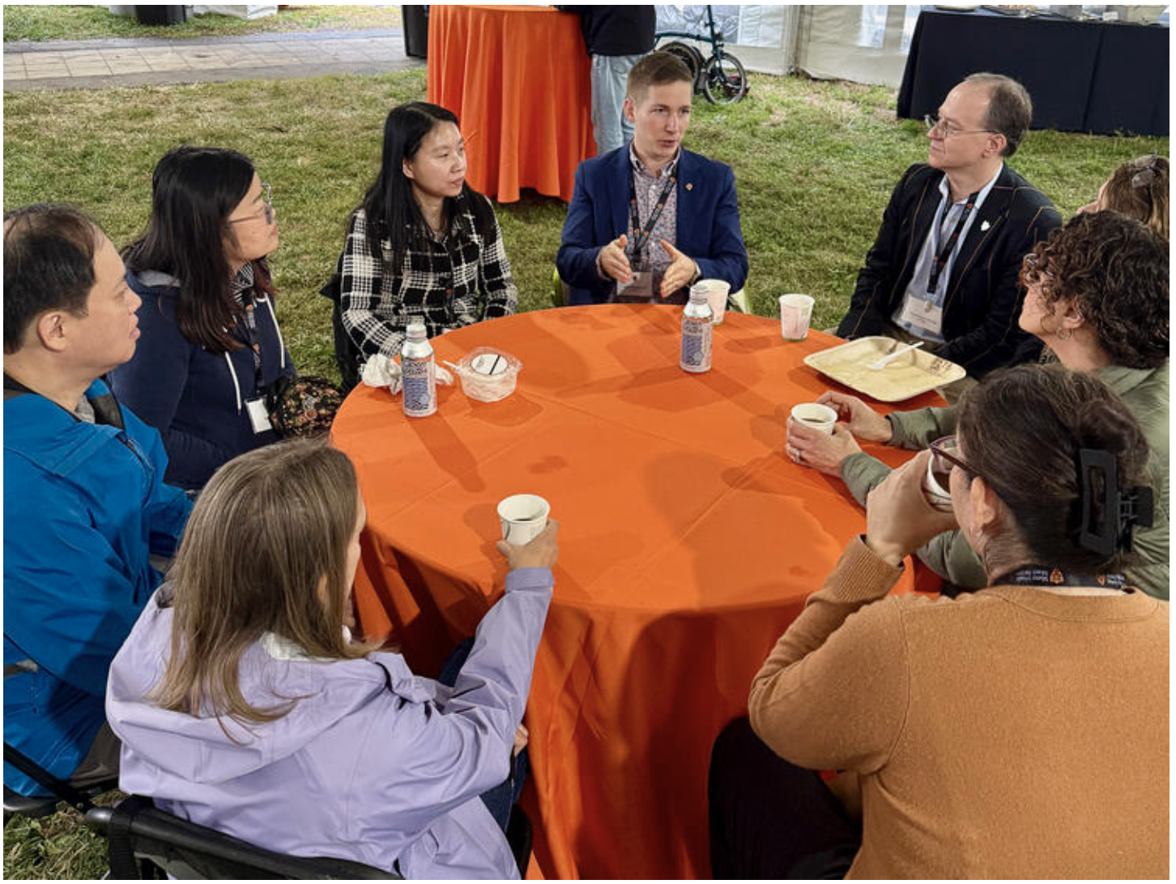
Engaging Graduate Alumni
Recruit graduate alumni to serve on your board
  Beyond existing roles, consider adding an officer position specifically responsible for graduate alumni engagement
Support graduate alumni specific events
  Precepts, social events, etc.
Add a graduate alumni element to existing club events
  Annual Meetings, New Admit Receptions
Send a customized welcome to new grad alums in your region
  APGA and Office of Alumni Engagement can assist
Guidance for Regional Clubs on Graduate Alumni Outreach
March 2023
Notes:
Anita covers

Slide 15

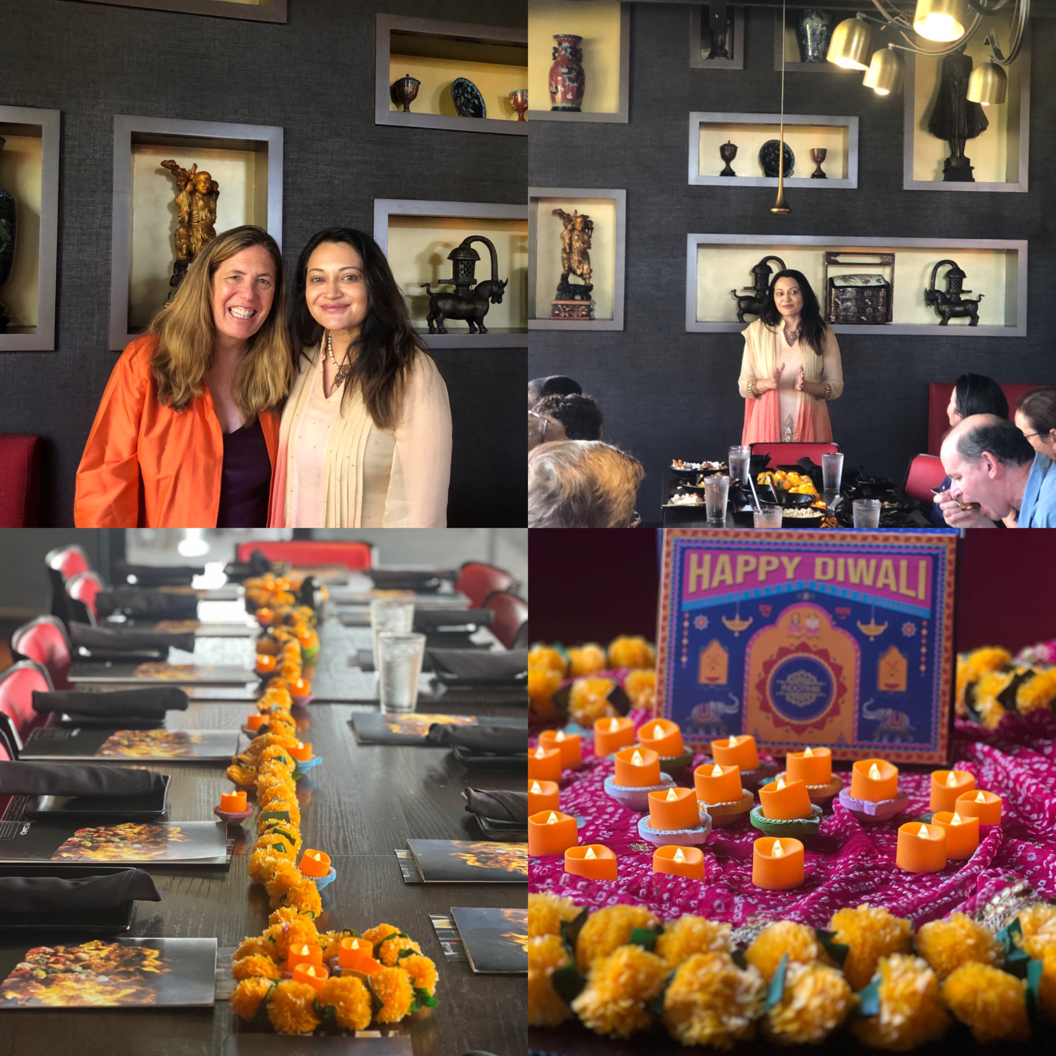
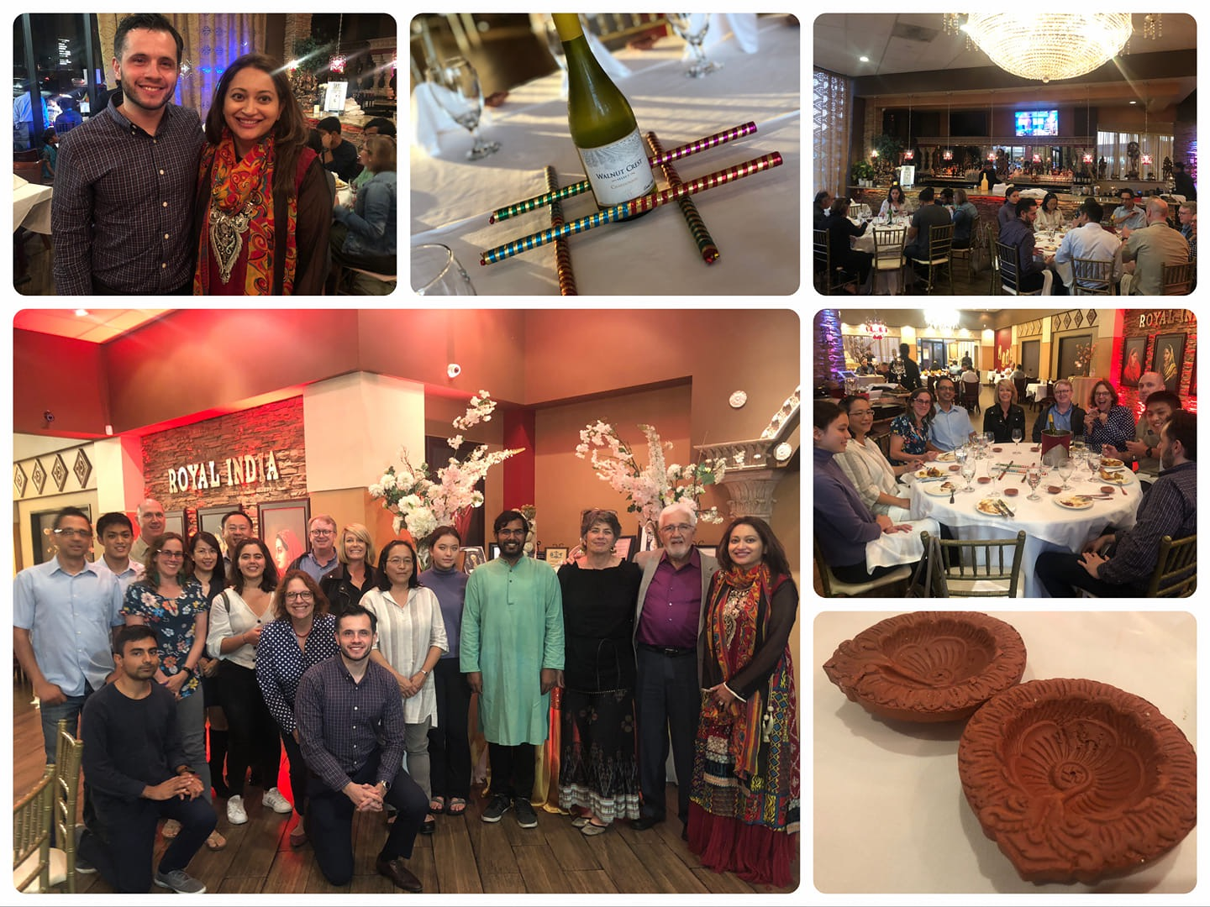

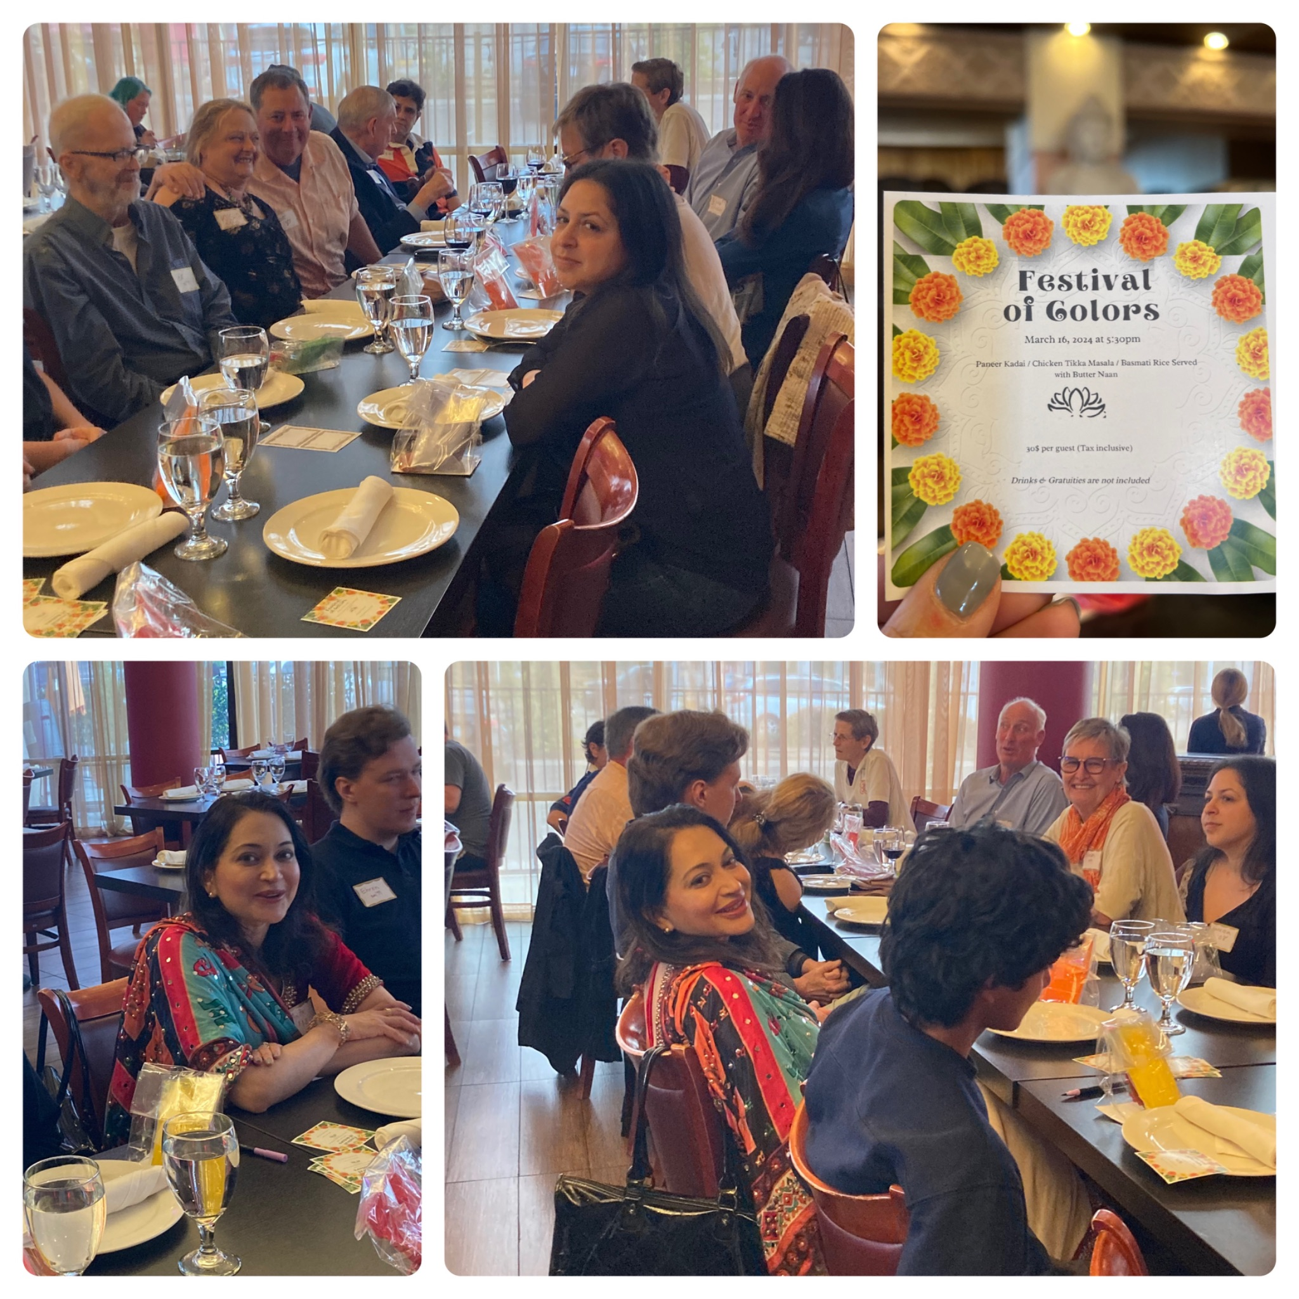
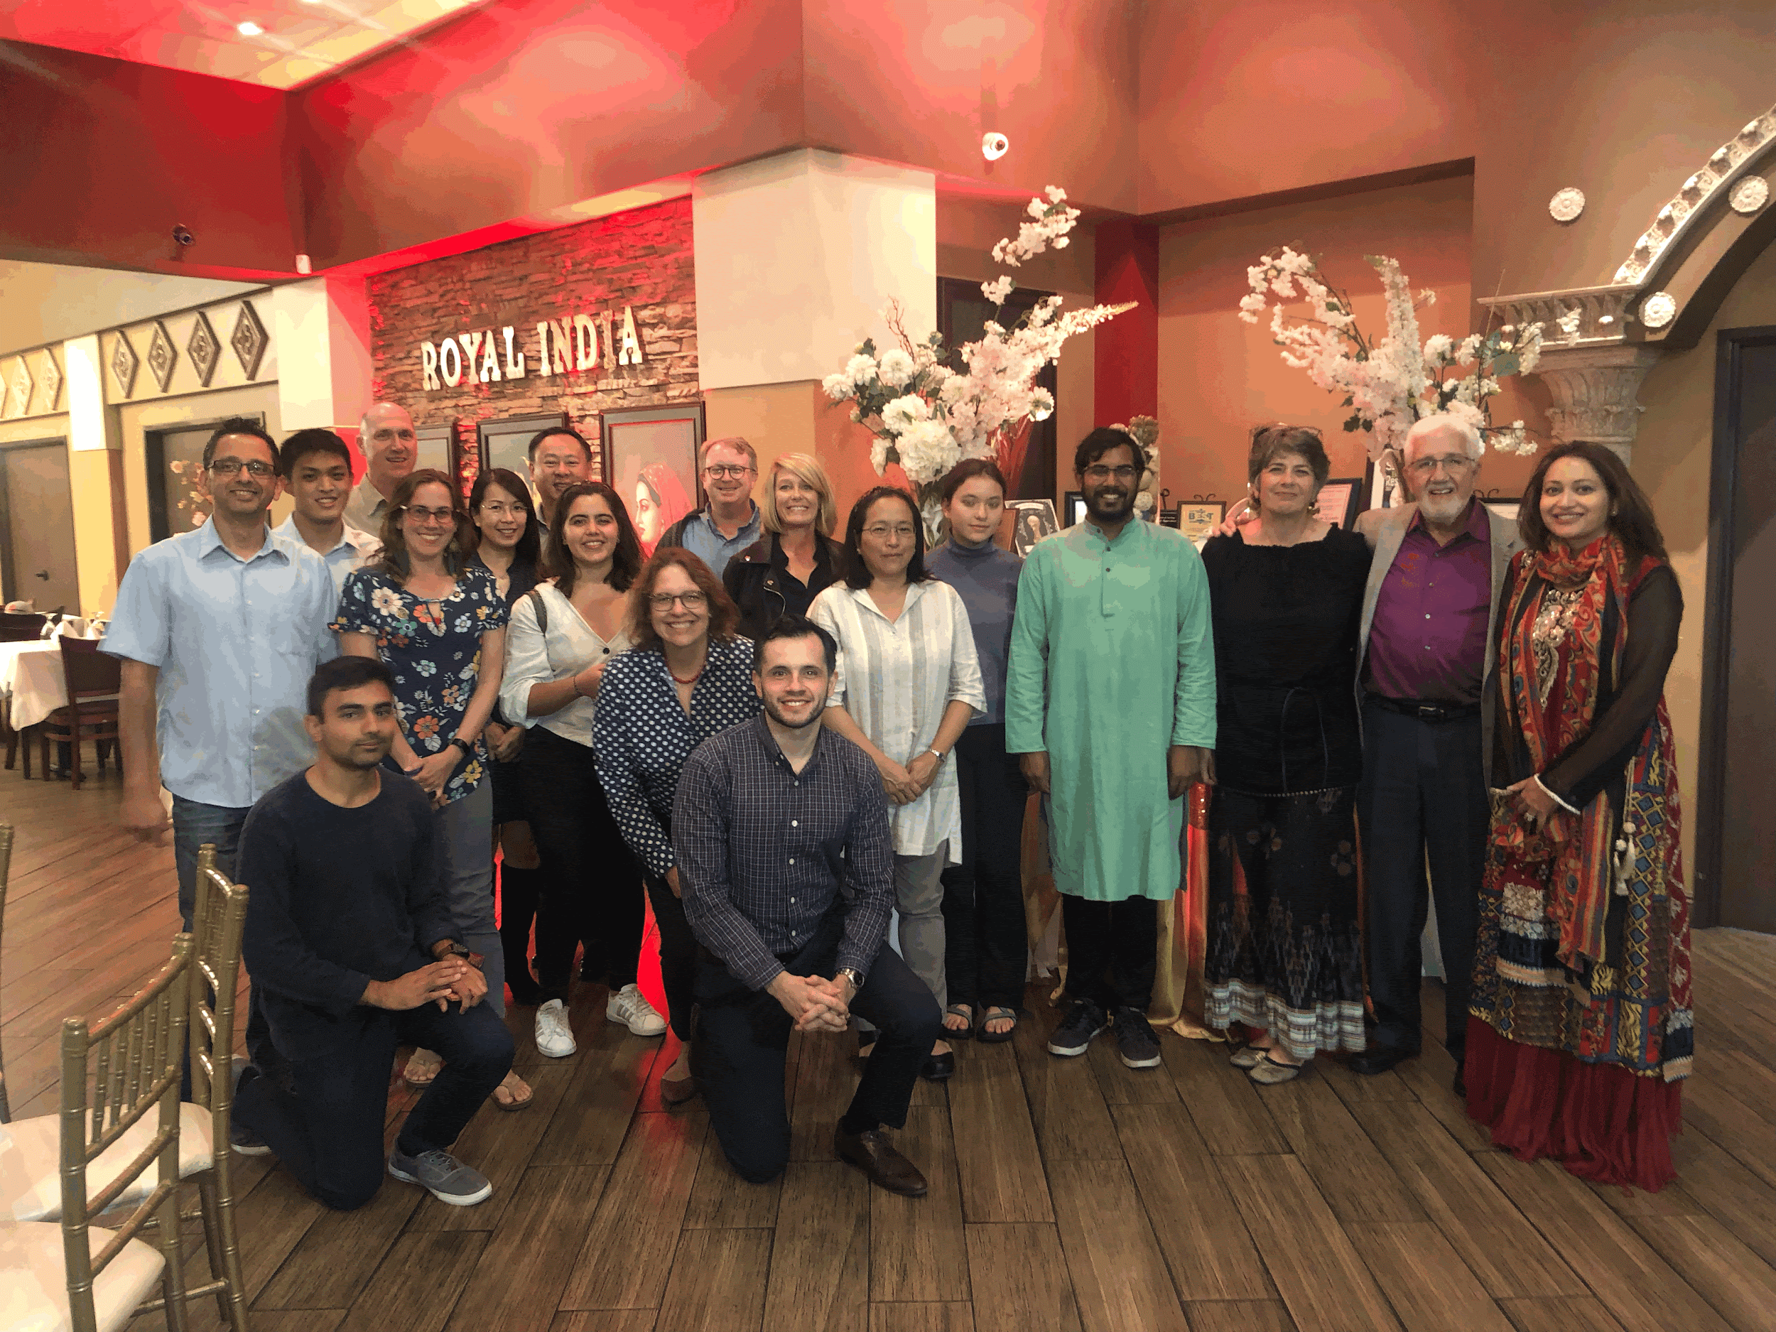
Princeton Club of San Diego / A4P / PWN / APGA
Notes:
Anita

Slide 16
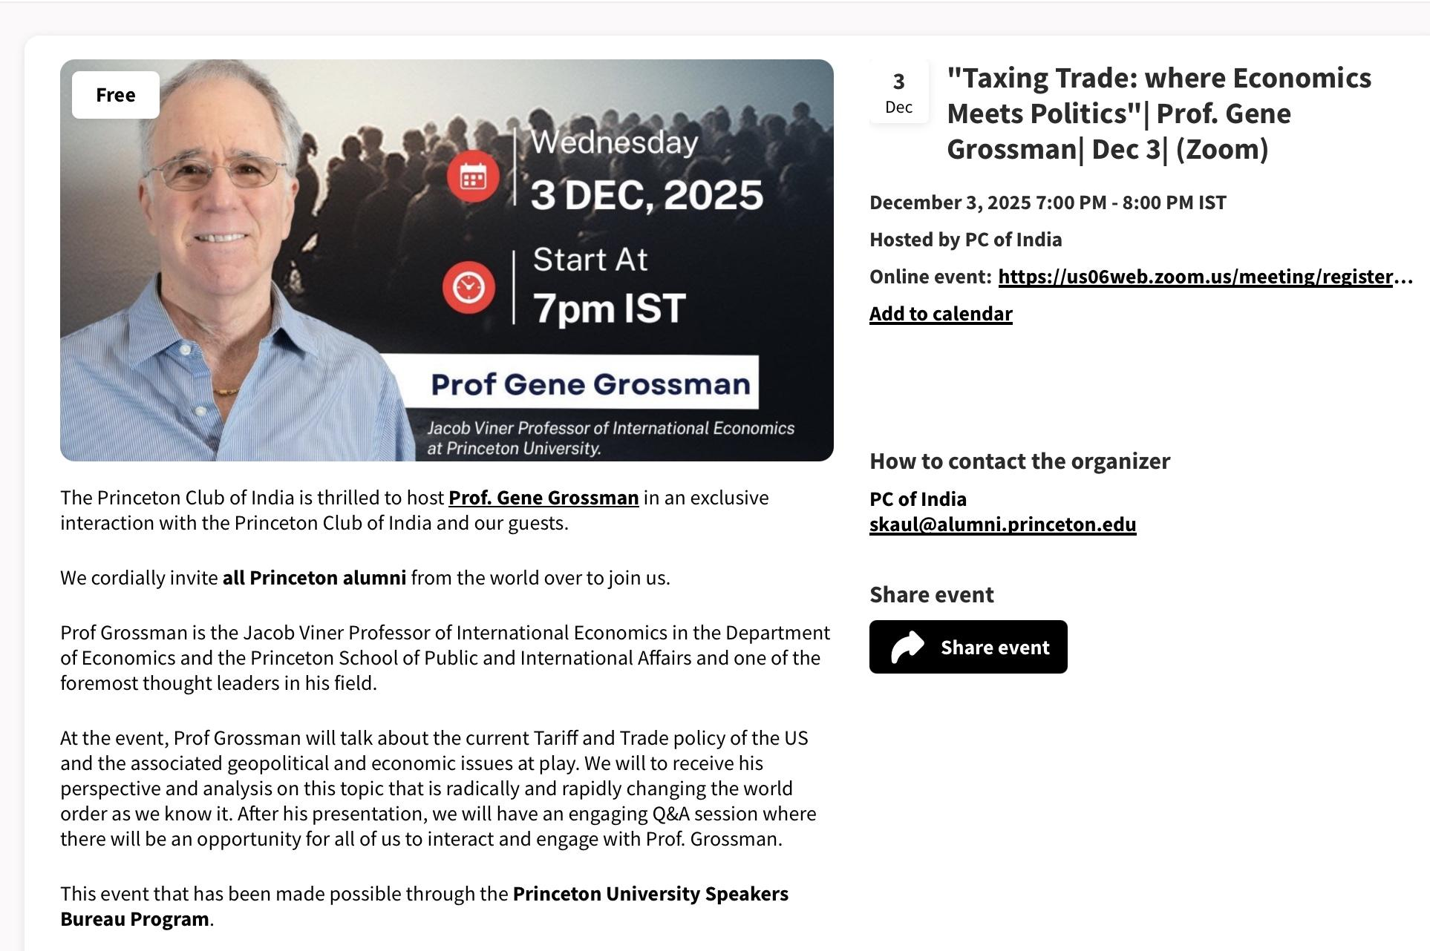
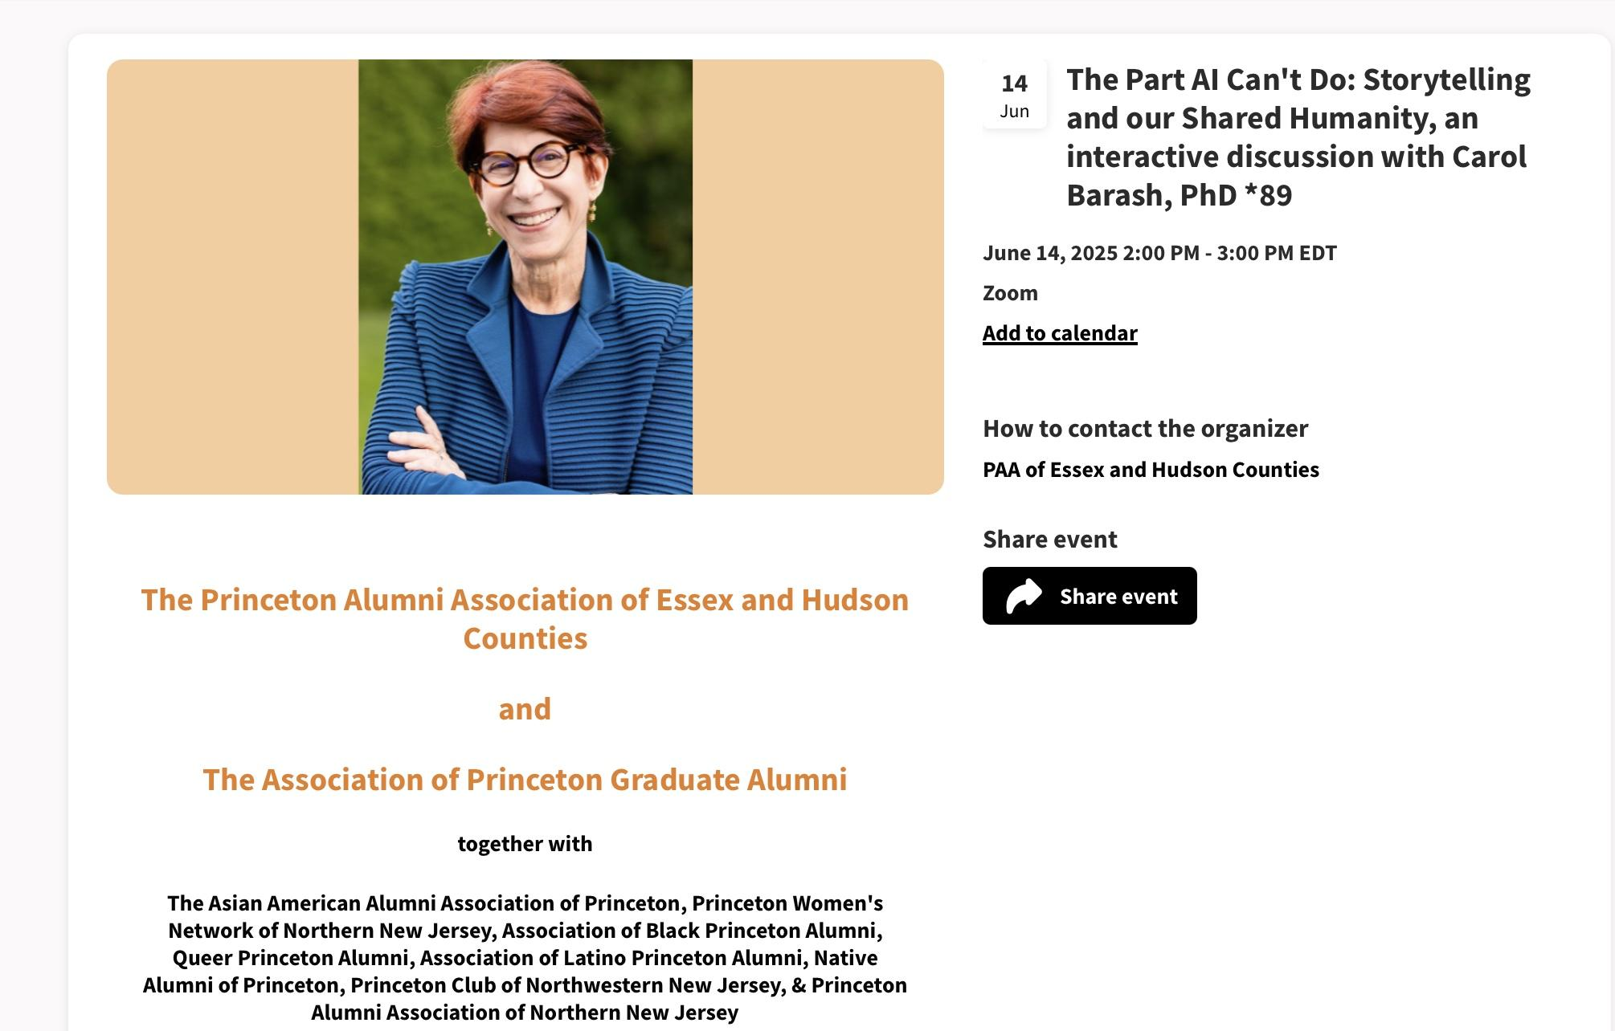
Princeton Club of India & PAAEHs Virtual Speaker Events
Notes:
Christina

Slide 17
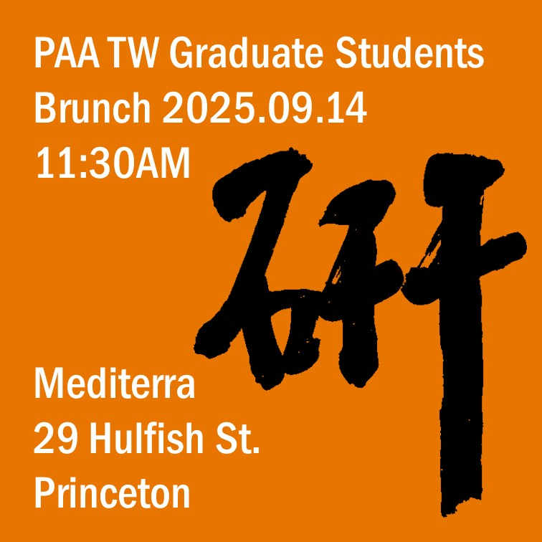
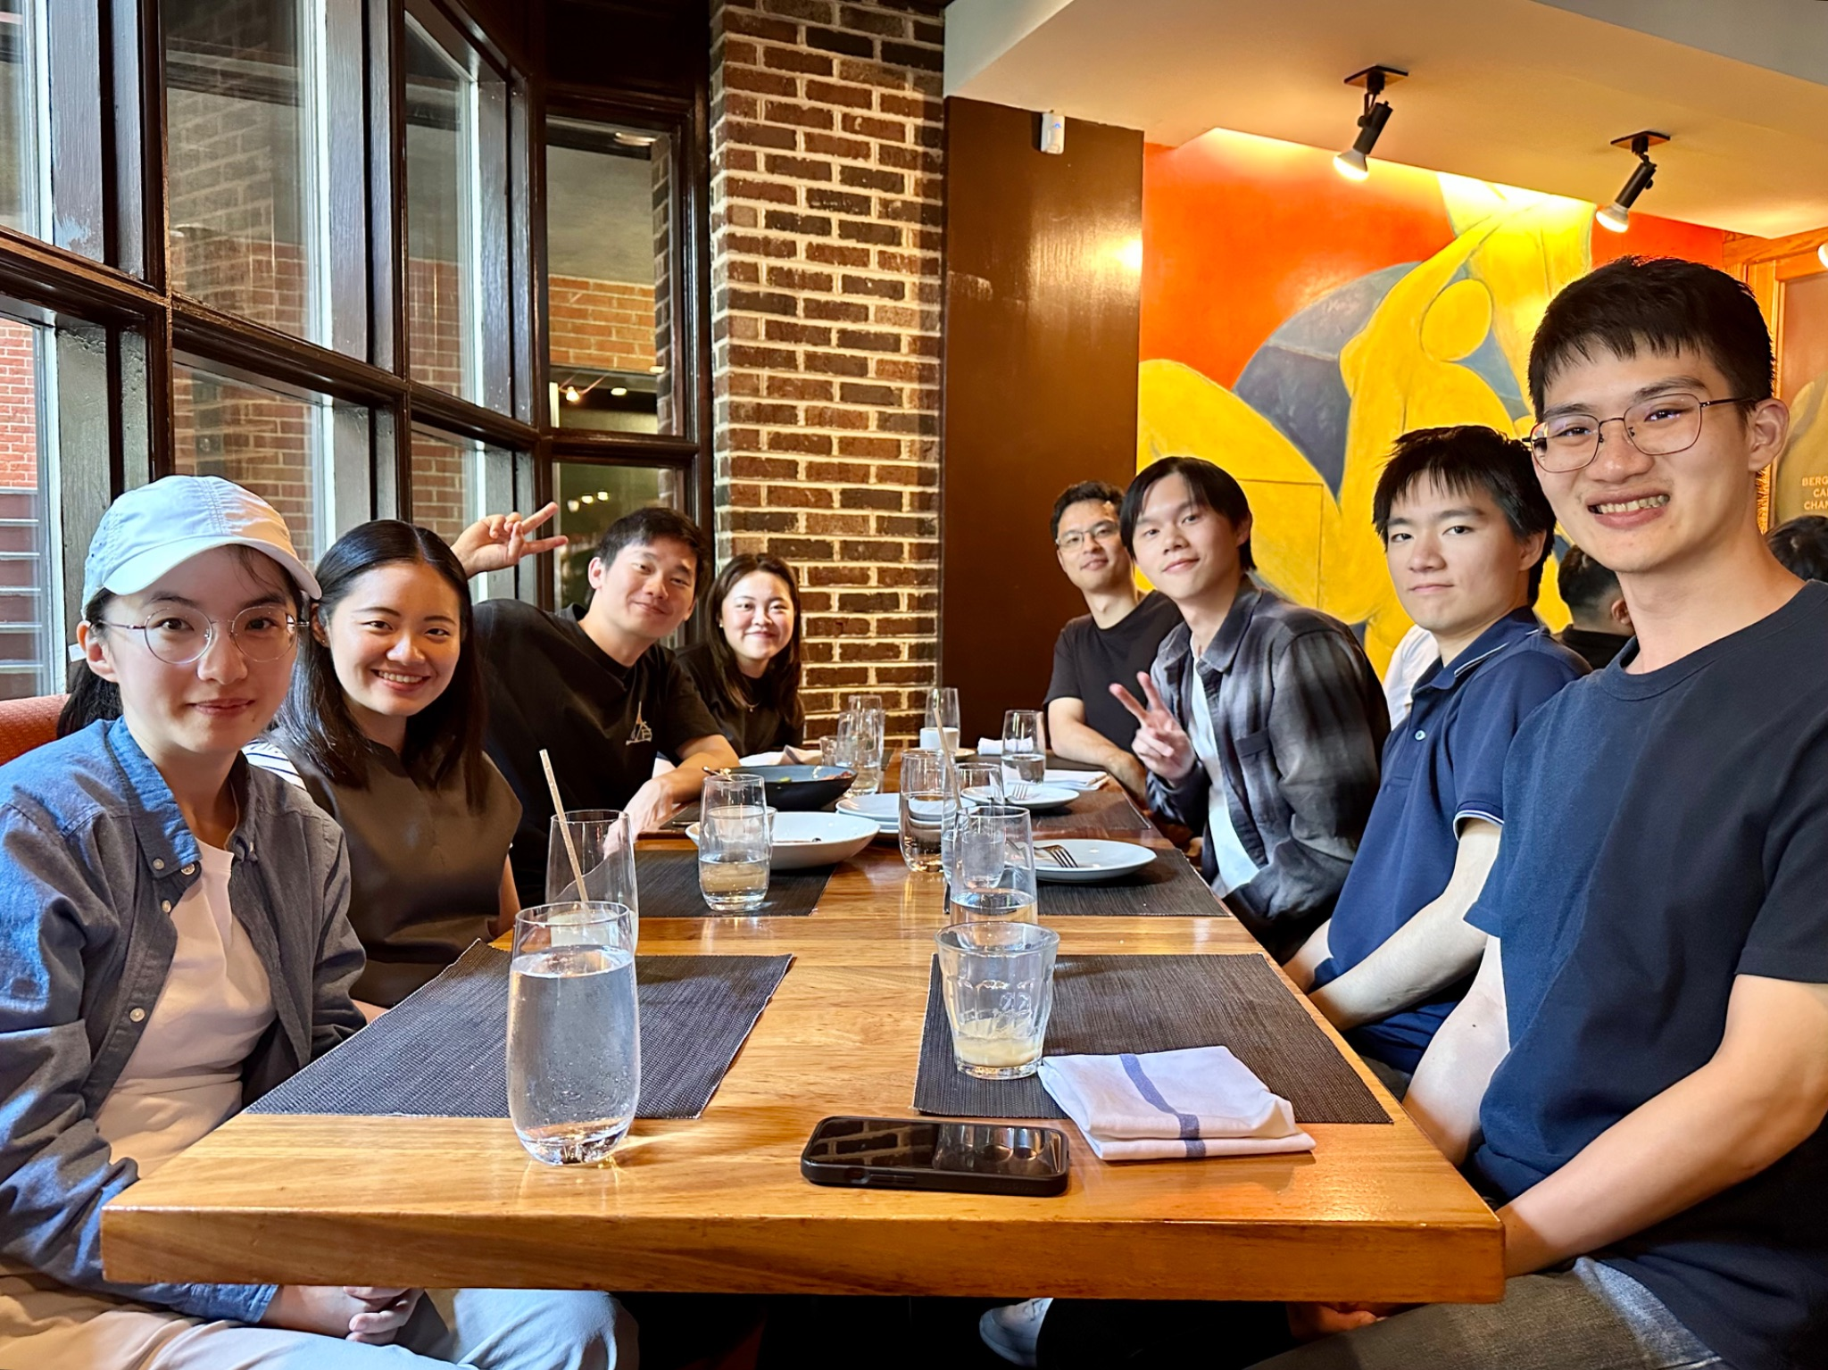
Princeton Club of Taiwan
Notes:
Christina

Slide 18
Resources
APGA Resources and Funding Opportunities
  (Regional Association Award nominations due December 31st!)
Inspired Conversations Toolkit
CORA Communications and Best Practices for Regional Associations
Speakers Bureau
  "Taxing Trade: Where Economics Meets Politics”- PC India’s/Prof. Grossman
TigerSide Chats:
  ‘The Princeton Graduate School’s 125 Years of Transformational Impact’ with Dean Rodney Priestley
Guidance for Regional Clubs on Graduate Alumni Outreach
  John Balfe *90/Angelina Sylvain *16, March, 2023
MMMS videos and other resources
Notes:
Scott covers, Christina (and guest?) highlights some events as well.

Slide 19
We are here for you
Scott J. Steele *03 P28
President
Princeton Club of Rochester
Member, CORA
Anita Gupta *18
Graduate Chair
Princeton Club of San Diego
Member, CORA
Notes:
Scott and Anita

Slide 20
Questions
Thank you for celebrating with us.
gradschool.princeton.edu | alumni@princeton.edu

